Slide 1
Team 1
Jonathan Hennessy-Doyle
Dario Tavares Antunes
Basil Contovounesios
Julius Mereckas

Slide 2
Our idea
Fairly big drinking problem among youths.
Create an app/website that aids with tracking of drinking funtivities.
Perform statistical analysis on data collected.

Slide 3
App/Website
Asks questions like
    How much do you want to drink ?
    How much did you drink last time ?
    How did you feel the day after ?
    Did you plan on drinking ?
    Etc.

Slide 4
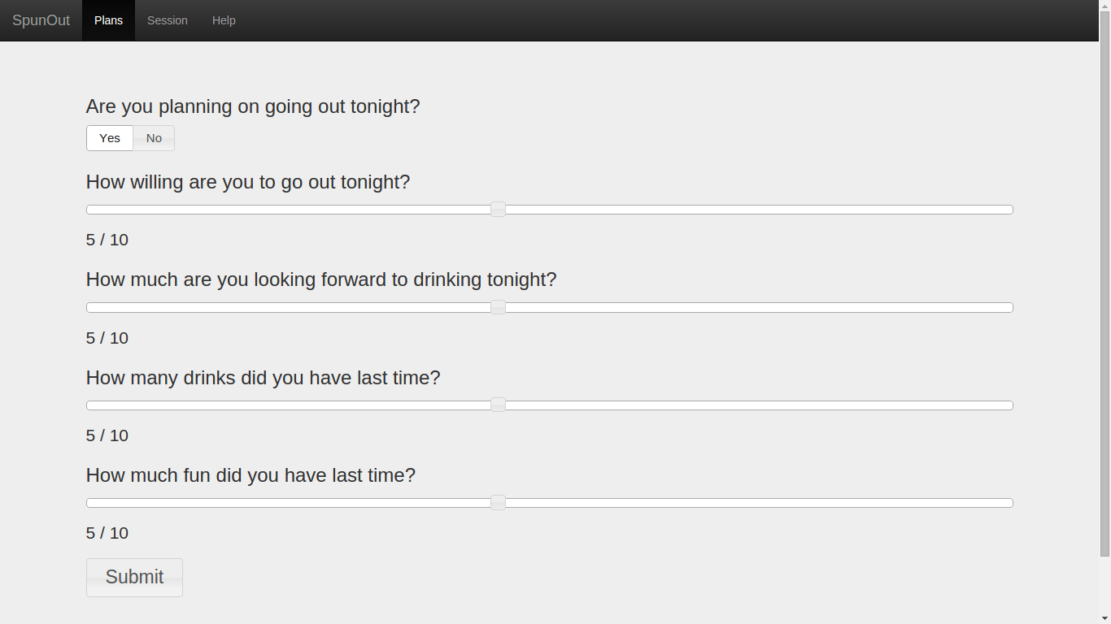

Slide 5
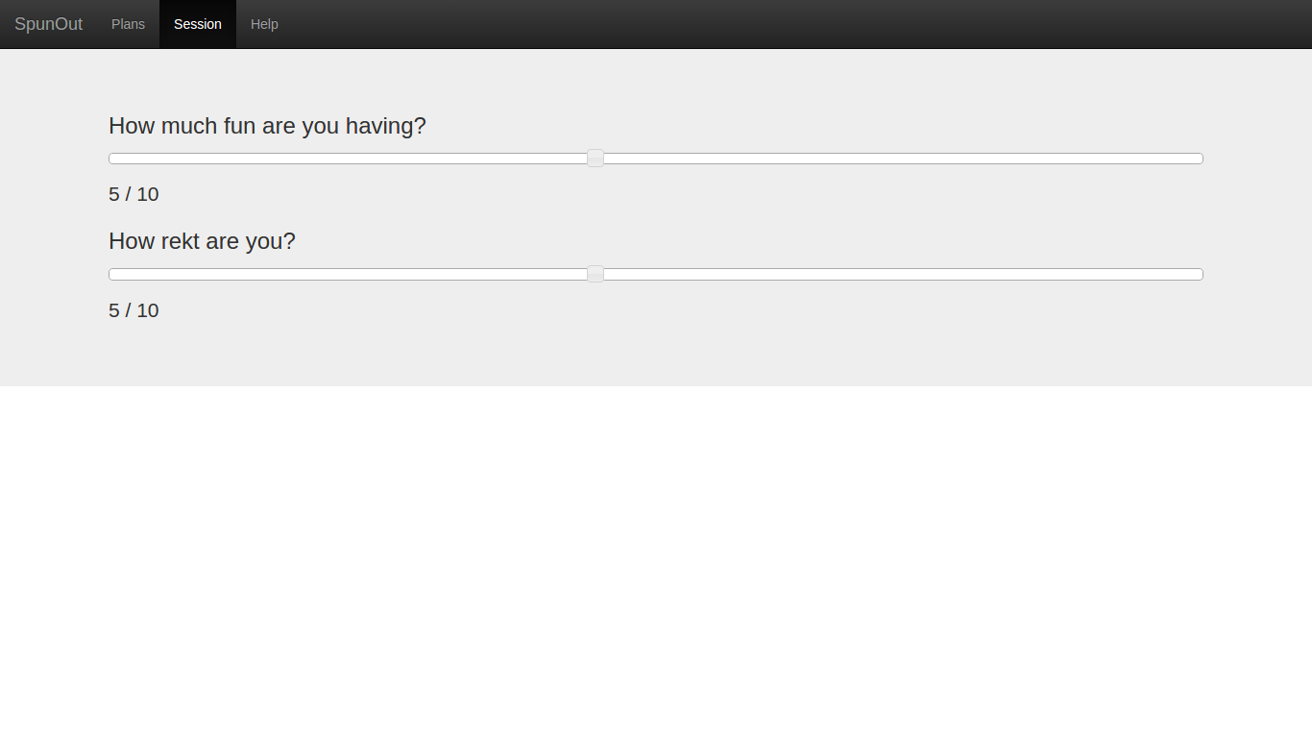

Slide 6
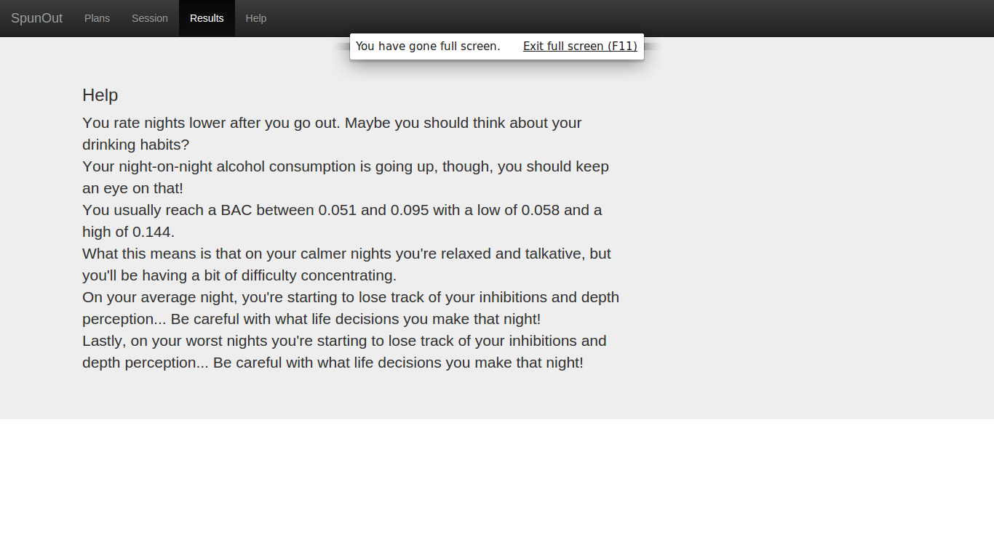

Slide 7
Analysis
Analyses the data you provided.
Feed back
  Your drinking patterns are show if you’re having less fun on nights out.
  Blood Alcohol Content over time
  Monitors tolerance
  Rates feeling through the night vs following morning
Stretch goals
  Offer help when negative patterns emerge.

Slide 8
How does it work ?
User answers a series of questions
Data is stored away in a database
Analysis engine takes data for each user
Performs some calculations
Analysis results are presented to the user

